Slide 1

Final Project Presentation
Group No.: 4
Sharvil Wadekar, Mohit Kamble, Soham Mane & Jiangyu Qin (David)
College of Professional Studies, Northeastern University
ALY (6070): Communicate/Visual Data Analysis
Prof.: Jack Bergersen
February 13, 2024

Slide 2

Overview
In studying NYPD arrest data using Tableau, we discovered trends in gender, offense frequencies, spatial variations, and changing age demographics.
These insights inform policing strategies and deepen our understanding of society.

Slide 3
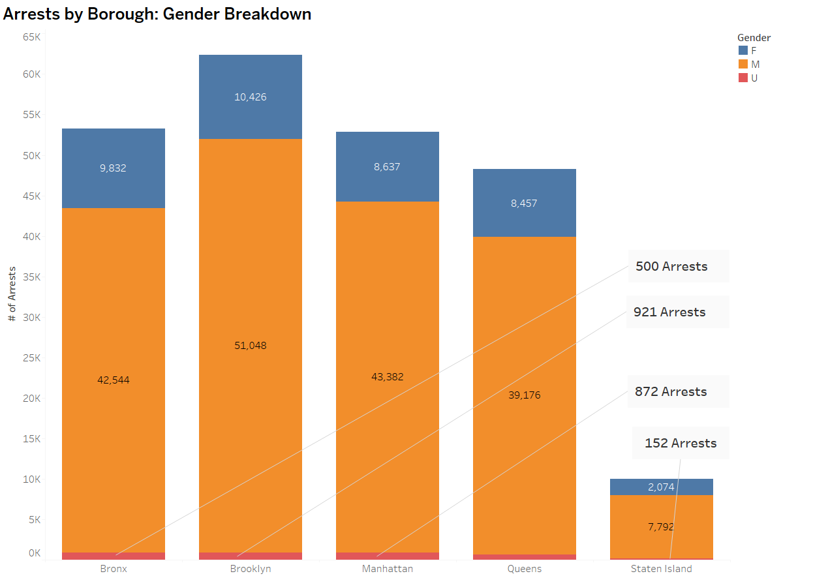
Research Questions
Q1) How do arrest rates differ across New York City boroughs, considering the gender of the individuals involved?

Slide 4
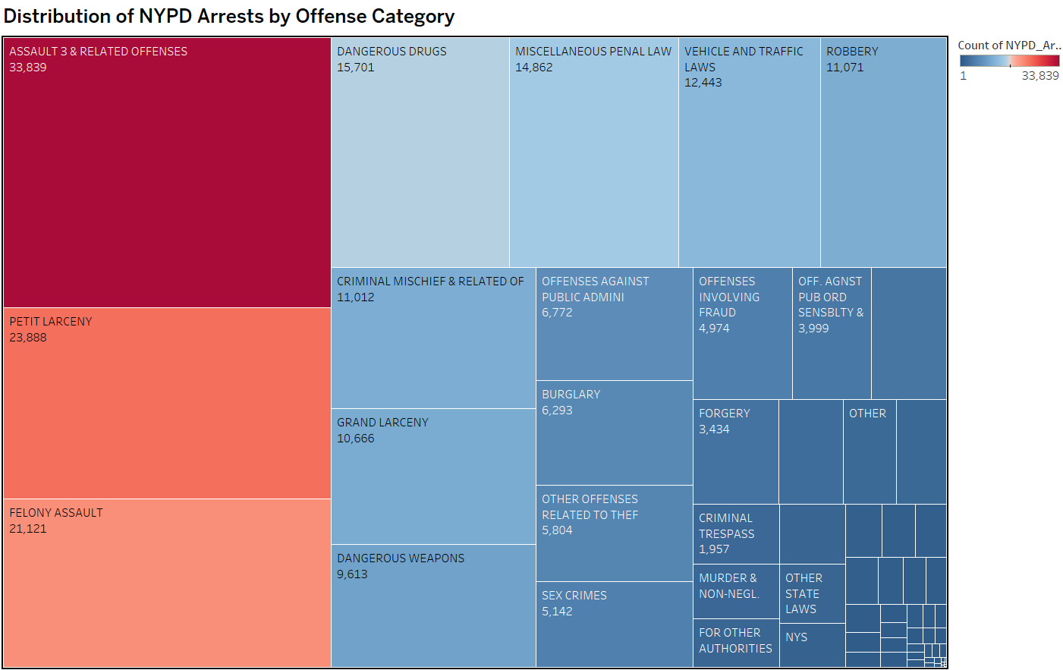
Research Questions
Q2) What are the primary categories of offenses in the NYPD arrest dataset, and how do their frequencies compare?

Slide 5
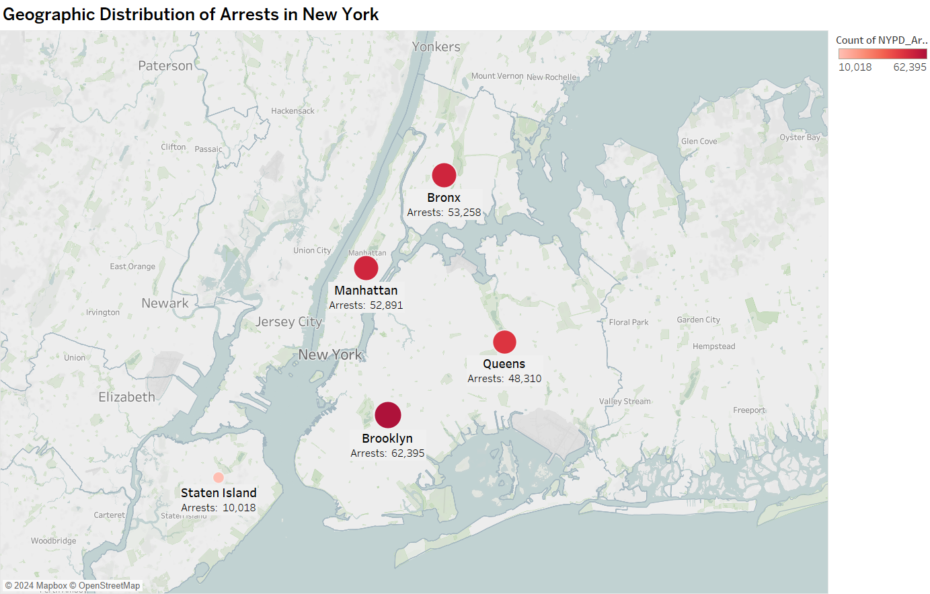
Research Questions
Q3) How do arrest counts vary spatially across the boroughs of New York City?

Slide 6
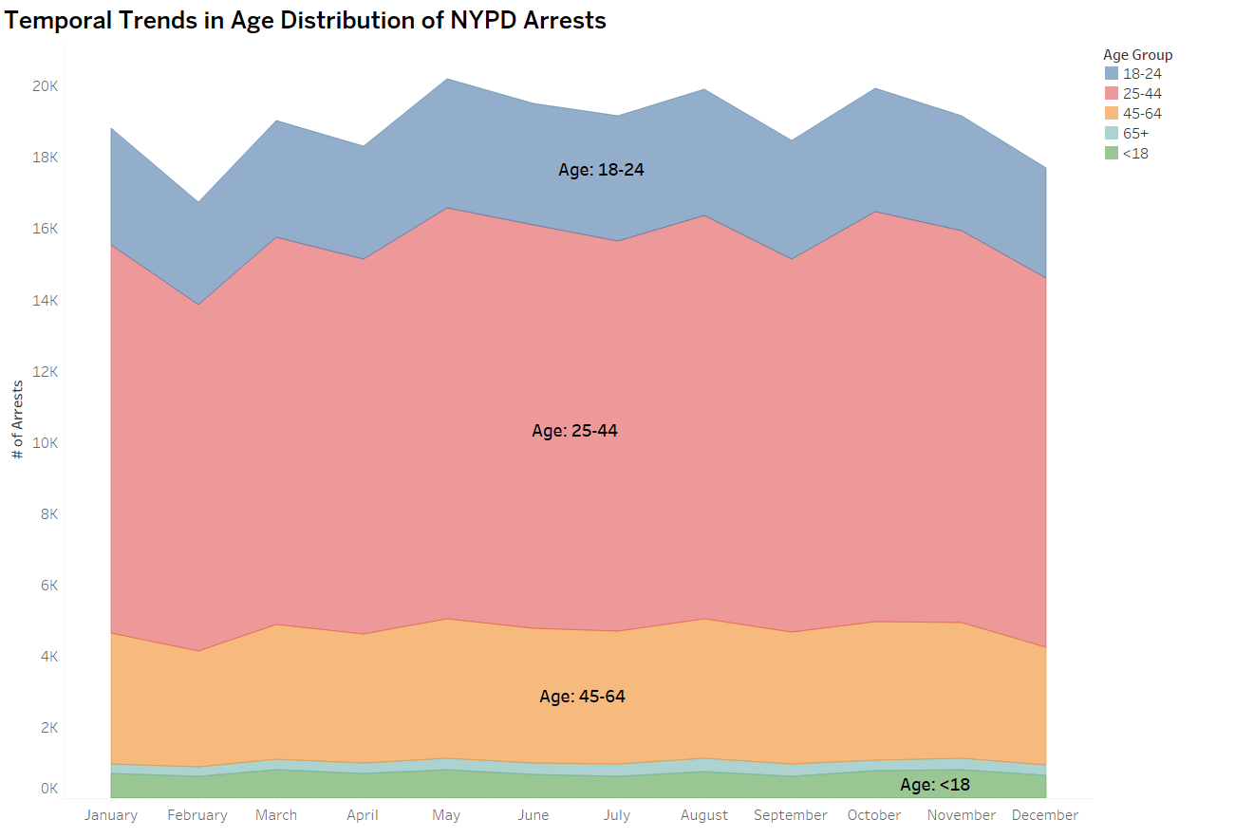
Research Questions
Q4) How does the distribution of arrests vary by age group over time, as depicted by the area chart visualization?

Slide 7
Conclusion
In wrapping up our exploration of NYPD arrest data using Tableau, we've unearthed significant insights into gender-specific trends, offense frequencies, spatial variations, and evolving age demographics.
These findings aren't just numbers, they represent real stories in the New York city.
The power of visualizations has not only revealed patterns but has armed us with knowledge crucial for shaping effective policing strategies and fostering a deeper understanding of the society.
This journey exemplifies how data visualization transforms complex information into actionable intelligence, guiding us towards more informed discussions and decisions in law enforcement and community engagement.
Citations
Dataset: source.
Insights:
I used linear regression to examine if the day of the week influences the order count.
The model indicates a potential decrease in order count as the day of the week increases.
While the p-value for order_dow is slightly above 0.05, suggesting caution, the intercept is statistically significant.

Slide 8
Thank You!
To summarize, In analyzing the dataset on E-commerce consumer behavior, I explored two questions to understand the relationships between variables.
Firstly, I investigated if the count of orders depended on the hour of the day.
The linear regression and hypothesis testing showed a moderate relationship, with a p-value close to the significance level.
Secondly, I examined the impact of the day of the week on the order count.
The results, while not reaching conventional significance, suggested a potential trend. In conclusion, the data suggests some associations between the timing of orders and order counts, though further investigation may be needed for conclusive insights.
Dataset: source.
Hypothesis Testing in R: source.
Anova Test: source.
Linear Regression: source.

